Slide 1

“AUTOMATIC DRILLING USING CNC AND FLATCAM”
Project Stage 2 Presentation on
PROJECT COORDINATOR GUIDE NAME HOD(E&TC)
PROF.T.K.ZOMBADE PROF.V.V.NALAWADE PROF.UPASANI D.E.
STUDENT NAME : | ROLL NO :
1. LINGE D.P. | B16ETB18
2.MORE.S.S. | B16ETB25

Slide 2
SR.NO. | CONTENTS
1. | INTRODUCTION
2. | PROBLEM STATEMENT
3. | SOLUTION
3. | OBJECTIVE
4. | LITERATURE SURVEY
5. | BLOCK DIAGRAM
6. | CIRCUIT DIAGRAM

Slide 3
SR.NO. | CONTENTS
7. | WORK DONE
8. | LIST OF SOFTWARE AND HARDWARE
9. | EXPECTED RESULTS
10. | APPLICATIONS
11. | SIMULATION
12. | PLAN FOR THE PROJECT

Slide 4
1.
INTRODUCTION
Machining is the part of manufacturing metal products and it is the art of removing material from it efficiently and it requires skill and requires energy if manual machining is to be done. In this proposed system , we are using the Arduino UNO for the purpose of automated machining. Arduino UNO controls the complete operations such as drilling, milling and lathing based on the G codes provided. This system is made as efficient as possible by making use of various open source softwares , low cost electronic components including controller and motors and made less complex by making use of the GRBL shield by reducing the wirings. The computer numerical control is used to provide the commands to the machine to perform the operation.
By taking into consideration the main motive of this project to reduce the time consumption and required man power and to increasing the efficiency and production rate and mainly making these machines affordable to the commoners as well as to the hobbyist of making products including drilling operation, we are presenting here the idea of “Automatic drilling using CNC and flatCAM”.

Slide 5
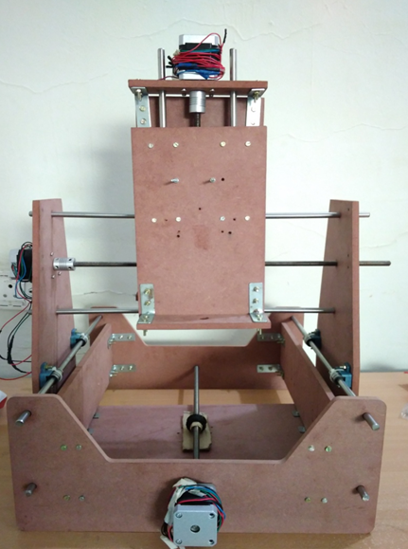
Continued..
CNC machine consists of the three main blocks namely input unit which is generally the USB, Serial Port, Ethernet through which the data about the part that is to be designed is given to the machine control unit. It consists of data processing unit i.e. ARDUINO Uno and control loop unit i.e. GRBL shield.

Slide 6
2.
PROBLEM STATEMENT
Machining is the part of manufacturing different metal product. And it is the art of shaping the work piece by removing material from it. There are different types of machining such as drilling , milling, lathe machining. Machining done by manual handling requires skill .There comes the limit on number of simultaneous operations like changing the tool, turning the coolant on/off etc. For designing the complex parts such as complex 2D or 3D geometries it consumes more time.

Slide 7
3.
SOLUTION
Problems coming in manual handling can be overcome by making use of CNC machine i.e. using a machine that works on numerical control commands given through the computer by the operator depending upon the type of part that is to be designed.
Our proposed CNC system consists of computer to give the G code commands. Generally it is a code telling the machine tool what type of action to perform, such as: Rapid movement (transport the tool as quickly to the drilling location). Input system consists of the USB which is used to transfer the PC data to the DPU (ARDUINO UNO) and control loop unit where the GRBL shield is used to control the stepper motors . Data processing unit and the control loop unit are nothing but the machine control unit. This machine control unit sends the necessary electrical signals to the driving system which comprises of the motors i.e. stepper motor and DC geared motor. Which in turn controls the machine tool movement.

Slide 8
4.
OBJECTIVE
To design the low cost affordable,3 axis drilling machine using ARDUINO Controller, CNC router and open source software for controlling the whole operation .
To reduce the time consumed, hard work required by making use of the the controller which will control all the operations and also using the highly efficient motors that can generate the high RPM and can control the machine tool movement efficiently.
To increase the production rate to greater extent .
To increase the accuracy and efficiency by using the GRBL shield (G code interpreter) which can act as a control loop unit . It controls the acceleration and deceleration.
To reduce the man power by designing the unmanned system i.e. once you set all the parameter required, the machine will start working without any human interfere it can work till 24 hrs.

Slide 9
4.
LITERATURE SURVEY
Gautam Jodh [1] discussed the design of computer numeric control drilling machine. Moving gantry type design of the machine was chosen. For frame structure steel angles were used to provide enough rigidity to the machine. Calculations were made considering different parameters to find out power requirements of the machine. For X, Y and Z axis drive, precision stepper motors were selected. The prebuilt open source software CMM was used to provide input to the machine. From the calculations and results, they concluded that machine had enough rigidity to work well even with mild steel.
Venkata Krishna [2] has discussed the mechanical, electrical, and software subsystems of the three-dimensional computerized numerical control machines. Stepper motors, linear rails and gearing arrangement were used in the mechanical system, low cost 8-bit Atmel 89C51 microcontroller and ULN 2803 stepper motor driver comprised the electronics system, the C# .net platform 3.5 and Keil compiler were used as software subsystem. They concluded that the use of all the open source software and low-cost hardware optimized the cost of the machine.

Slide 10
Continued….
M. Bhavani [3] designed, implemented and constructed the mini CNC machine for PCB drawing and drilling, wood engraving and glass cutting. The GRBL firmware was used to interpret the G-code and converting it to electrical signals to control the actuators. The MCU used was ARDUINO Uno development board based on Atmega 328 microcontroller, which was responsible for controlling important parameters of the machine, like feed rate, depth of cut, and spindle speed etc. The GT2 timing belts were used instead of lead or ball screws to reduce the cost. The communication between the computer and the MCU was done using universal serial bus.
Dr. B Jayachandriah [4] fabricated a 3-axis CNC router based on the three machine subsystems. The mechanical system consisted of ball screws, ball bearings, linear rods, linear ball bearings, shaftsand shaft couplings. The electrical system comprised of power supply, stepper motors and microcontroller board. The free CAD software like FreeCAD were used to create the mechanical models to be fabricated on the machine. The CAM Software like G-Simple, Free mill etc. were used to generate G-code files to send to the machine controller using GCODE Sender software.

Slide 11
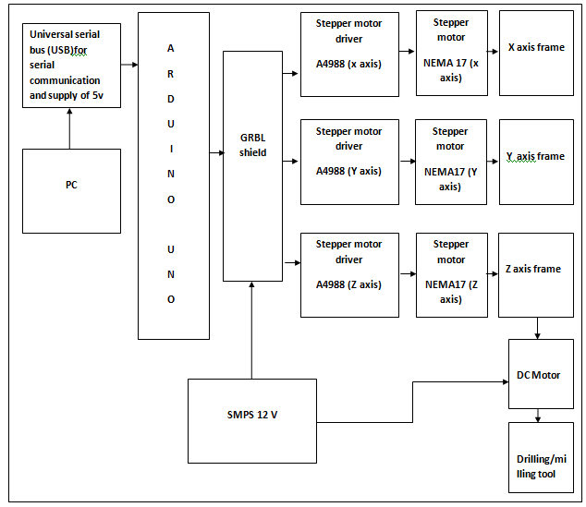
5.
BLOCK DIAGRAM
FIG. (1) BLOCK DIAGRAM OF PROPOSED SYSTEM

Slide 12
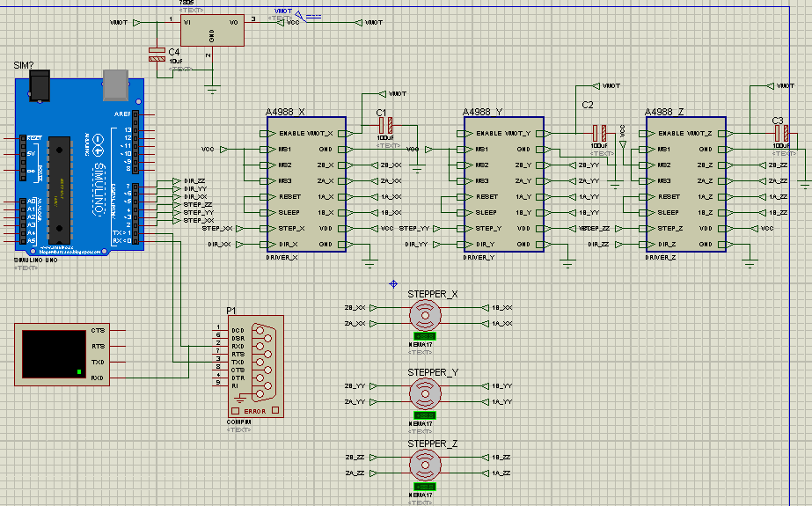
6.
CIRCUIT DIAGRAM
FIG. (2.1) CIRCUIT DIAGRAM OF PROPOSED SYSTEM (PARENT SHEET)

Slide 13
7.
WORK DONE
In project stage 1 we had gathered all the required material for our project and done the structuring of the CNC machine. We designed the structure of CNC machine on sheet. We made the 15”” x14” dimension CNC machine.
In project stage 2 we started the actual hardware implementation of CNC machine which included the bearing assembly, base assembly, Y axis frame assembly(Gantry), X and Z axis frame assembly. We did the CNC programming and CNC simulation on CNC simulator. We also studied the various softwares that can be used to complete the project.
Currently we are working on assembling the stepper motors to the X,Y and Z axis frames and also working on assembling the lead screws to the appropriate locations. We are done with the universal G code sender and interfacing the GRBL with the ARDUINO and uploading the GRBL firmware to the ARDUINO.

Slide 14
8.
LIST OF HARDWARE AND SOFTWARE REQUIRED
ELECTRONICS COMPONENTS REQUIRED:
ARDUINO UNO BOARD
GRBL SHIELD
STEPPER MOTOR
STEPPER MOTOR WIRES
1000RPM DC MOTOR
EASY DRIVER CIRCUIT
MECHANICAL HARDWARE REQUIRED:
MFD
TOOLS AND CHUCK
ALUMINIUM STEEL BAR
THREADED STAINELSS 8mm ROD
M8 NUTS
DRILL MACHIENE
MOTOR CLAMPS
COUPLER
LINEAR RAILS
SOFTWAREs REQUIRED:
EAGLE
FlatCAM
Universal Gcode sender software
GRBL firmware
ARDUINO

Slide 15
9.
EXPECTED RESULTS
Using small machine tools to fabricate small scale parts can provide both flexibility and efficiency in manufacturing approaches and reduce capital cost, which is beneficial for small business. ARDUINO based 3 axis PCB drilling machine is to be designed and implemented under very limited budget.
From this project, we can get a machine which has high accuracy and low cost as compared to large CNC machine.

Slide 16
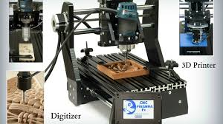
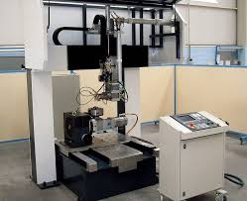
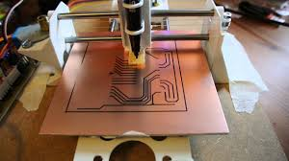
10.
APPLICATIONS
2. Laser welding
1. 3D Printer
3. PCB Plotting

Slide 17
11.
SIMULATION
We had done the CNC simulation on CNC simulator.
We had done the simulation on the universal G code sender software, to send the G code to the system and it also gives the idea about the machine tool movement while doing its operation.

Slide 18
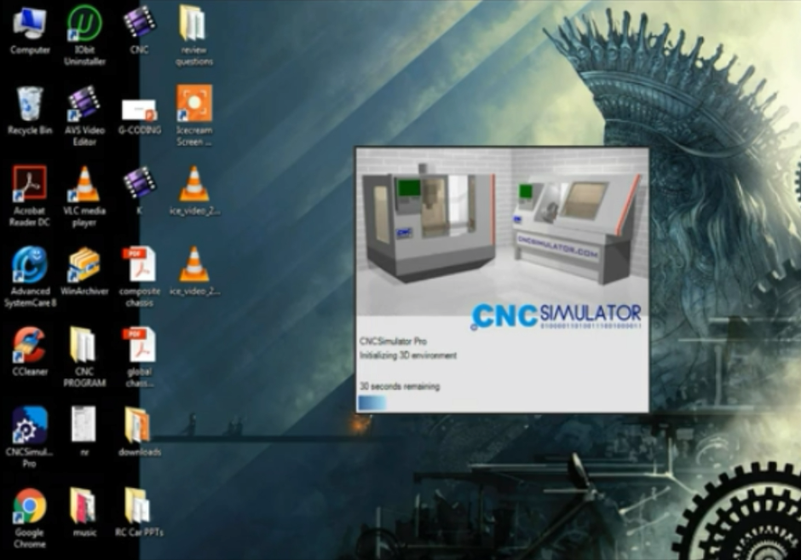
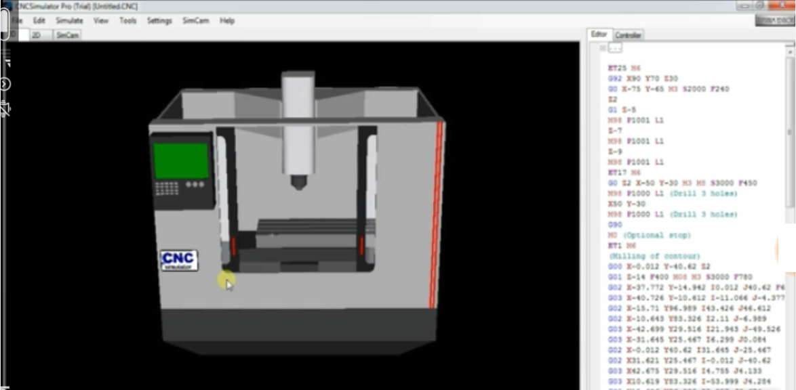
CNC SIMULATION

Slide 19
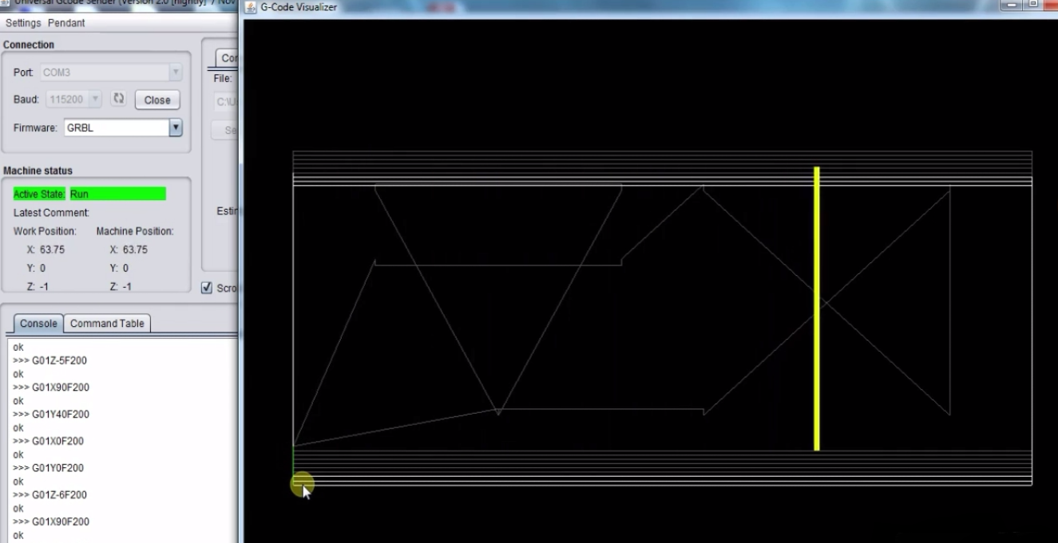
UNIVERSAL G CODE SENDER

Slide 20
12.
PLAN FOR THE PROJECT
MONTH | ACTIVITY
June | Group formation
July | Searching of the topic, literature survey
August | Registration of the project, abstract submission
September | Study and selection of the components
October | Designing the structure of CNC Designed the bearing assembly and base frame assembly. CNC simulation on CNC simulator.
November | Y axis frame assembly and X and Z axis frame assembly Combined assembly of all the frames together. Report writing

Slide 21
Month | Activity
December | Project stage 1 report submission Machine tool assembly Interface the GRBL shield with ARDUINO by uploading the GRBL firmware. Simulation on universal G code sender software.
January | Structural assembly Lead screw assembly Placing leadscrew nuts with axis frame Bed assembly.
February | Interfacing the motor driver and stepper motor with CNC shield. Assembly of ARDUINO and GRBL Setting up SMPS Powering up the CNC machine Interfacing with universal g code sender.
March | Creating schematic on Eagle and creating the drill files Creating .NC file on flatCAM Checking the output on OTHERPLAN or universal G code sender software. Report writing
April | Report submission

Slide 22
ANY QUESTIONS?

Slide 23
THANK YOU

